Slide 1
University of Cyprus
VeLoCity Project
Presenters: Dr. Alexandros Yeratziotis
SEIT Lab Researcher
ayerat01@cs.ucy.ac.cy
Department of Computer Science
University of Cyprus

Slide 2
VeLoCity Project
Introduction
The aim of the VeLoCiTy project is to facilitate the individuals that try to find a job in another country by making them familiar with the diversity in the theories and practices of the interviews, partially as a result of the culture and ethnics differences among the European countries through an innovative 3D virtual world learning environment that will include scenarios simulating the most representative interview processes.

Slide 3
VeLoCity Project
Objectives
To explore and apply traits of multicultural interview behaviours and diverse ethnic characteristics into the simulation learning tool in order to maximise the skills and the competence of Europeans.
To eliminate physical barriers and create equal opportunities for adults from heterogeneous ethnic backgrounds to collaborate, broaden their views and mind, exchange ideas and engage in constructive dialogue.

Slide 4
VeLoCity Project
Objectives
To provide the opportunity to adult learners to adapt to diverse working environments, and interviews.
To influence, motivate, and provide the opportunity to interested stakeholders to utilise and extend the scenarios, and deliver a scalable and expandable open source virtual learning tool in terms of functionality and learning material.

Slide 5
VeLoCity Project
Idea
Even since the beginning of the economic crisis, the amount of unemployed citizens grew in the EU, leading in many cases to a necessity of finding a job in a different country.
There has been a rise on migration related to job searching, but in many cases the situation surrounding that move is very difficult for the migrant potential worker.

Slide 6
VeLoCity Project
Idea
According to the statistical 2013 publication from the Organisation for Economic Cooperation and Development (OECD): “Immigrants have been hard hit, and almost immediately, by the economic downturn in most OECD countries.
This is mainly explained by their greater presence in sectors that have been strongly affected by the crisis (e.g. construction, manufacturing, retail trade and financial sectors) as well as by their greater likelihood of being in precarious or informal jobs.

Slide 7
VeLoCity Project
Idea
The ongoing economic downturn has seen unemployment rates increase, both for foreign- and native-born persons, in most OECD countries.
However, immigrants in most European OECD countries were more affected by unemployment than the native population.

Slide 8
VeLoCity Project
Our Goals
Educating potential job seekers to become familiar with the process of interviews.
Developing a pioneer virtual world learning environment where several forms of interviews will be simulated.
Giving users the opportunity to gain the soft skills in order to be antagonistic in the labour market of every European country.

Slide 9
Consortium

Slide 10
VeLoCity Project
Funding
The VeLoCiTy project is an ERASMUS+ Key Action 2 Strategic Partnerships for adult education project.
Foundation for the Management of European Lifelong Learning Programmes.
Ίδρυμα Διαχείρισης Ευρωπαϊκών Προγραμμάτων (ΙΔΕΠ) Διά Βίου Μάθησης

Slide 11
VeLoCity Project
Target Groups
Unemployed and misemployed adults
Older people
VET organizations
NGOs
Consulting organizations

Slide 12
VeLoCity Project
Intellectual Outputs
IO1: Needs Analysis of job interviewees in term of training needs
Review of the most popular theories of job interviews tips and techniques, pedagogical approaches and results from questionnaires that were conducted in each partner country.

Slide 13
VeLoCity Project
Intellectual Outputs
IO 2: VeLoCiTy Interview process methodology
7 interview case scenarios in English based on the results from IO1 with tutorial/guidelines that explain the case scenarios guiding the interviewees in the procedure of each scenario.

Slide 14
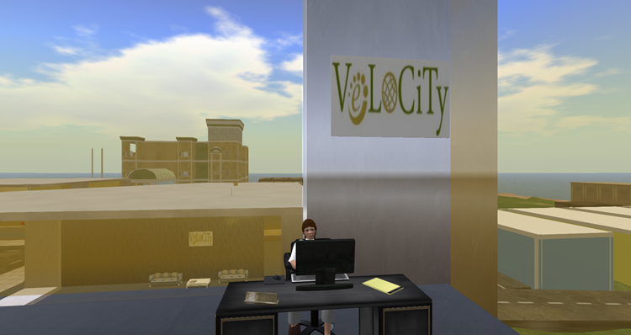
VeLoCity Project
Intellectual Outputs
IO 3: VeLoCiTy virtual learning environment
An open source 3D virtual world which will simulate interviews with a detailed manual to help participants learn how to use the virtual learning environment.

Slide 15
Thank you!
www.cs.ucy.ac.cy/seit

